Slide 1
Innovation & Technological Developments within Corporate Actions
Presented by:
Harry Rana, Senior Business Analyst
5 September 2012

Slide 2

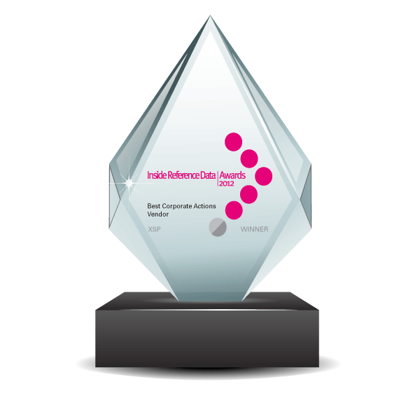
About XSP
Established in 1996
Exclusively Dedicated to Corporate Actions Automation
60+ Clients on 4 Continents
Partner of SWIFT, DTCC and XBRL
Accredited with SWIFTReady Corporate Actions Label for the Past 8 Consecutive Years
Winner of the 2012 Inside Reference Data Corporate Actions Vendor Award

Slide 3
Corporate Actions Today
Economic Uncertainty Breeds Risk
Rising Corporate Actions Volumes
Rising Corporate Actions Complexity
Threat of Eurozone Disintegration
Increased Exposure to Emerging Markets and Exotic Instruments
Advent of Cloud

Slide 4
Corporate Action Risk Points
Data Quality and Timeliness
Data Comparison
Integration of Back Office Information:
  Securities
  Accounts
  Eligible Positions

Slide 5
Corporate Action Risk Points
Global Operations Based in Multiple Locations
Notification to Clients
Client Response Capture
Responding Back to Custodians/PB
Stagnation of Growth Due to Lack of Scalability
Impact of Move to the Cloud

Slide 6
Data Quality and Timeliness
XBRL Initiative & DTCC Re-Engineering
  DTCC, SWIFT and XBRL US are building an XBRL Corporate Actions taxonomy based on, and aligned with, the ISO 20022 repository elements
  DTCC, SWIFT and XBRL US will leverage the expanding adoption of XBRL in the U.S.
  DTCC will also create a unique ID to be associated with each Corporate Action announcement upon its creation

Slide 7
Data Quality and Timeliness
XBRL Initiative – Benefits
  Issuers: The intent and content of the originating offer will be clear to the investor, without fear of misinterpretation due to manual manipulation
  Financial Services Industry: The manual interpretation, re-keying and manual exceptions will be significantly lessened
  Investors: The data comes directly from the issuing source without manual intervention or interpretation by third parties

Slide 8
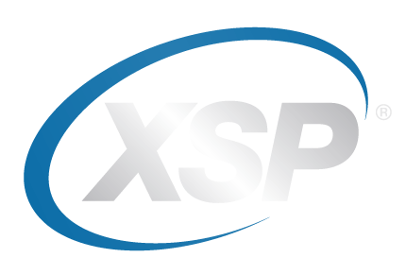
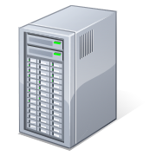








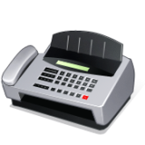

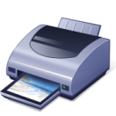











System Overview
Corporate Actions Data Scrubbing and Notification Process
NOTIFICATION DISTRIBUTION
Created and Sent from Toolbar or Application Server via Scheduled Task
CLIENT BACK-OFFICE SYSTEMS
Client Internal Files (e.g., Positions, Transactions, Other Client Data)
DATABASE SERVER
XSP Database
CUSTODIAN DATA
Custodians, Prime Brokers, Depots
SWIFT GATEWAY
eTRAN+ WEB-BASED
TOOL
ISO
ISO MT564/8
NOTIFICATION
VENDOR DATA
30+ Supported
Vendor Interfaces
FILE SERVER
XSP-Specific Directory Structure
APPLICATION SERVER
File Listener, Scheduled Tasks, Business Objects
EMAIL
PRINTER SERVER
FAX
OTHER SOURCES
Newspapers,
Reports, etc.
TOOLBAR USERS
Data Scrubbing for input of other data sources
RECIPIENTS

Slide 9
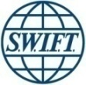




















System Overview
Response Processing – Voluntary Corporate Actions
SWIFT
ISO MT565 INSTRUCTION
ISO MT566
ISO MT567
ELECTION RESPONSES
ISO MT567 CONFIRMATION
RECIPIENTS
ISO MT566 CONFIRMATION OF PAYMENT
SWIFT GATEWAY
ISO MT566
CUSTODIANS/
PRIME BROKERS/
DEPOTS
ISO MT567
ISO MT565
ISO MT567
ISO MT566
ISO MT565
WEB
BROWSER
ISO MT567
ISO MT565
FILE SERVER
ISO MT566
INTERNAL
WEBSITE
ELECTION RESPONSES
eTRAN+
WEB-BASED
TOOL
Accessed via
Web Browser
WEB SERVER
RECIPIENTS
APPLICATION SERVER
File Listener, Scheduled Tasks, Business Objects
ENTITLEMENT FILE
PROCESS ISO MT565
ACKNOWLEDGE ISO MT565
EMAIL
PHONE
FAX
ELECTION RESPONSES
CLIENT ACCOUNTING
SYSTEM
File Interface Updates Accounting System
RECIPIENTS
TOOLBAR USERS
for Data Management and Scrubbing
DATABASE SERVER
XSP Database

Slide 10
Avoiding Stagnation and Gaining Scalability
Operational Example:
  With XSP, a Global Private Bank Corporate Actions department went from 400 accounts to 400,000 accounts with only one additional FTE
  This same bank is working with XSP to further automate the Corporate Action process to gain an additional seven FTEs in year-end savings…all through technology and SWIFT Messaging

Slide 11
Avoiding Stagnation and Gaining Scalability
Technology Example:
  Operations are under pressure to move away from Excel spreadsheets and printed paper, but are having to wait on tech resources and budgets to free up to meet growing client demand
  No longer tied down by IT costs – Cloud and SaaS are viable alternatives

Slide 12

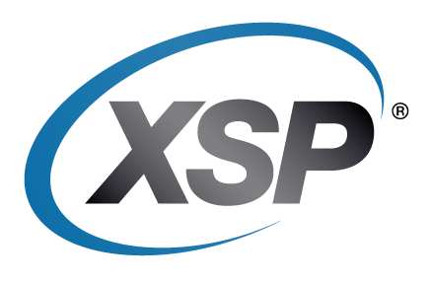
What is the Cloud
The Cloud is an technology solution that provides computing resources, software and/or services from a remote location.
The Cloud is an architectural approach to both hardware and software for offering remote computing, software and/or services over the Internet.
The Cloud assumes that the ancillary processes surrounding these computing resources and processes are taken care of by the Cloud provider.

Slide 13
Business and IT Leaders Say Cloud Enables Agility
Cloud Computing
IT Agility
Business Agility
Business Performance
80%+ associate business agility with revenue growth, cost reduction, and risk management
63% agree cloud can have a significant impact in making business more agile and responsive
Companies with enterprise-wide cloud deployments are 3x more likely to achieve business agility that is “much better than competition”
SOURCE: Global Business Agility Survey, February 2011

Slide 14
Mobility as a Business Enabler
6 Billion Mobile Subscriptions Worldwide
1.2 Billion Active Mobile-Broadband Subscriptions Worldwide
2011 VC Investment in Mobile + $6.3 Billion
Mobile
Revolution
Ubiquitous
Broadband
Intuitive
Interaction
Cloud Enablement

Slide 15
The Mobile/Cloud Connection
Mobile Computing
Business Agility
IT Agility
Cloud Computing
Business Performance
60% CIOs List Mobility as #1 Strategic Priority in 2012, vs. 50% in 2011
CIOs Responding to Rise in Demand for Mobile due to Business Enablement Factors and CoIT
70% CIOs Increasing Investment in Cloud Computing in 2012 vs. 56% in 2011
Evidence Points to Mobile Adoption Rates Pushing Cloud Application and Investment
SOURCE: Global CIO Survey, May 2012

Slide 16
Impact to Corporate Actions Automation
Key Impediments
  Timelines
    Long Delivery Cycles
  Resources
    Resource-Intensive
    Annual Updates
  Budgets
    Variable & Usage-Based vs. Fixed Costs
  Reach
    Mobile vs. Fax/Print

Slide 17
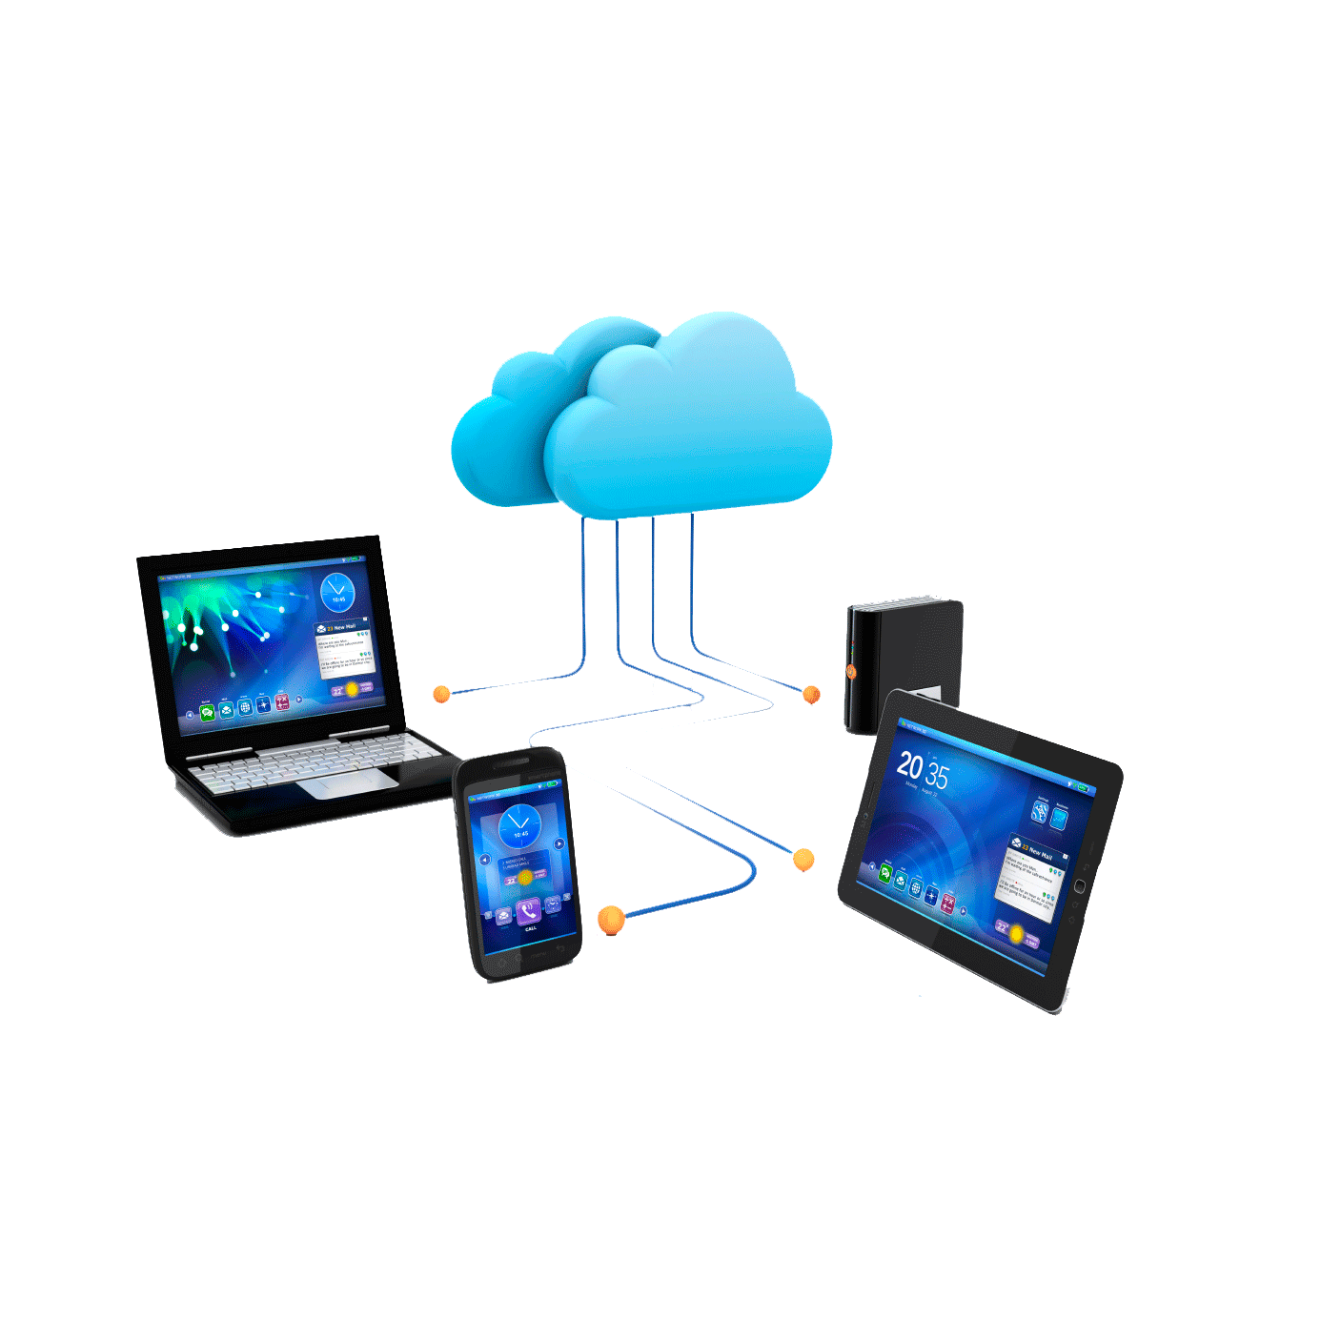
Impact to Corporate Actions Automation
Key Enablers
  Innovation
    Cloud Reduces Time to Market
    Cloud Encourages Experimentation
  Industry
    Business Enablement vs. IT Project
  Focus
    Business Value and Clients are Top Priority
  Reach
    Close the Loop with the Front Office

Slide 18
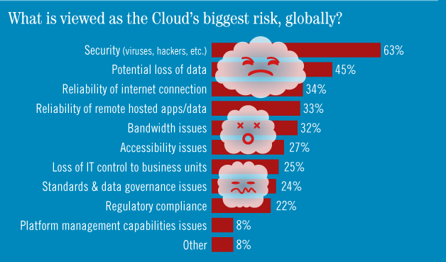
What We’re Hearing

Slide 19
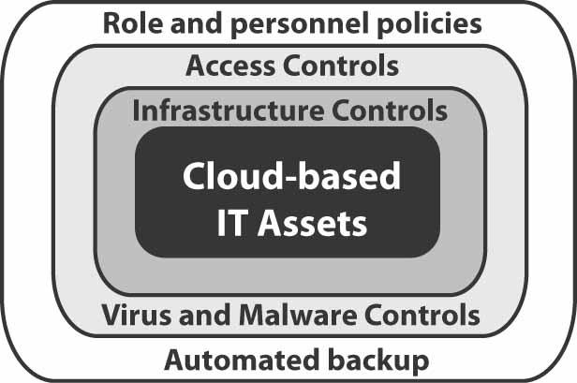
Security and Privacy in the Cloud
THREAT | COUNTERMEASURE
Unauthorized physical access to cloud-based computing assets | Infrastructure access controls
Unauthorized system access | Information security controls (e.g. password encryption) Access controls (e.g. authentication, authorization) Identity management
Unauthorized access to data | Data location management
Theft of data | Database access controls
Virus and malware | Data security software
Hardware failure or disaster | Data reliability processes (e.g. automated backup and replication)

Slide 20
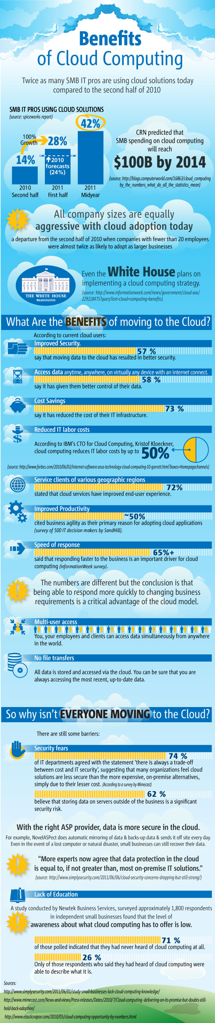
What We’re Seeing
“…while cloud computing does introduce a number of new potential risks for corporate I.T. departments, we can manage those risks and provide a level of security and risk management that is equal to or often superior to the norm for on-premise datacenters.”
-Tier 3
Reduce IT Operations burden and costs via advanced Orchestration and Automation
Exceeds Security and Compliance Needs
SMTA, vSAN protect customer data
Secure, low-latency direct connections
SAS 70 Type II and SSAE16 audited

Slide 21
In Summary
Challenging Times Call For Mitigation of Risk
Technology Can Alleviate Risk in Corporate Action Pain Points
Technology Can Also Allow Teams to Grow Without an Increase in Risk
New Technology Can Also Be Leveraged to Shorten Development Cycles, Lower Costs, Lower Resources and Empower End Clients

Slide 22
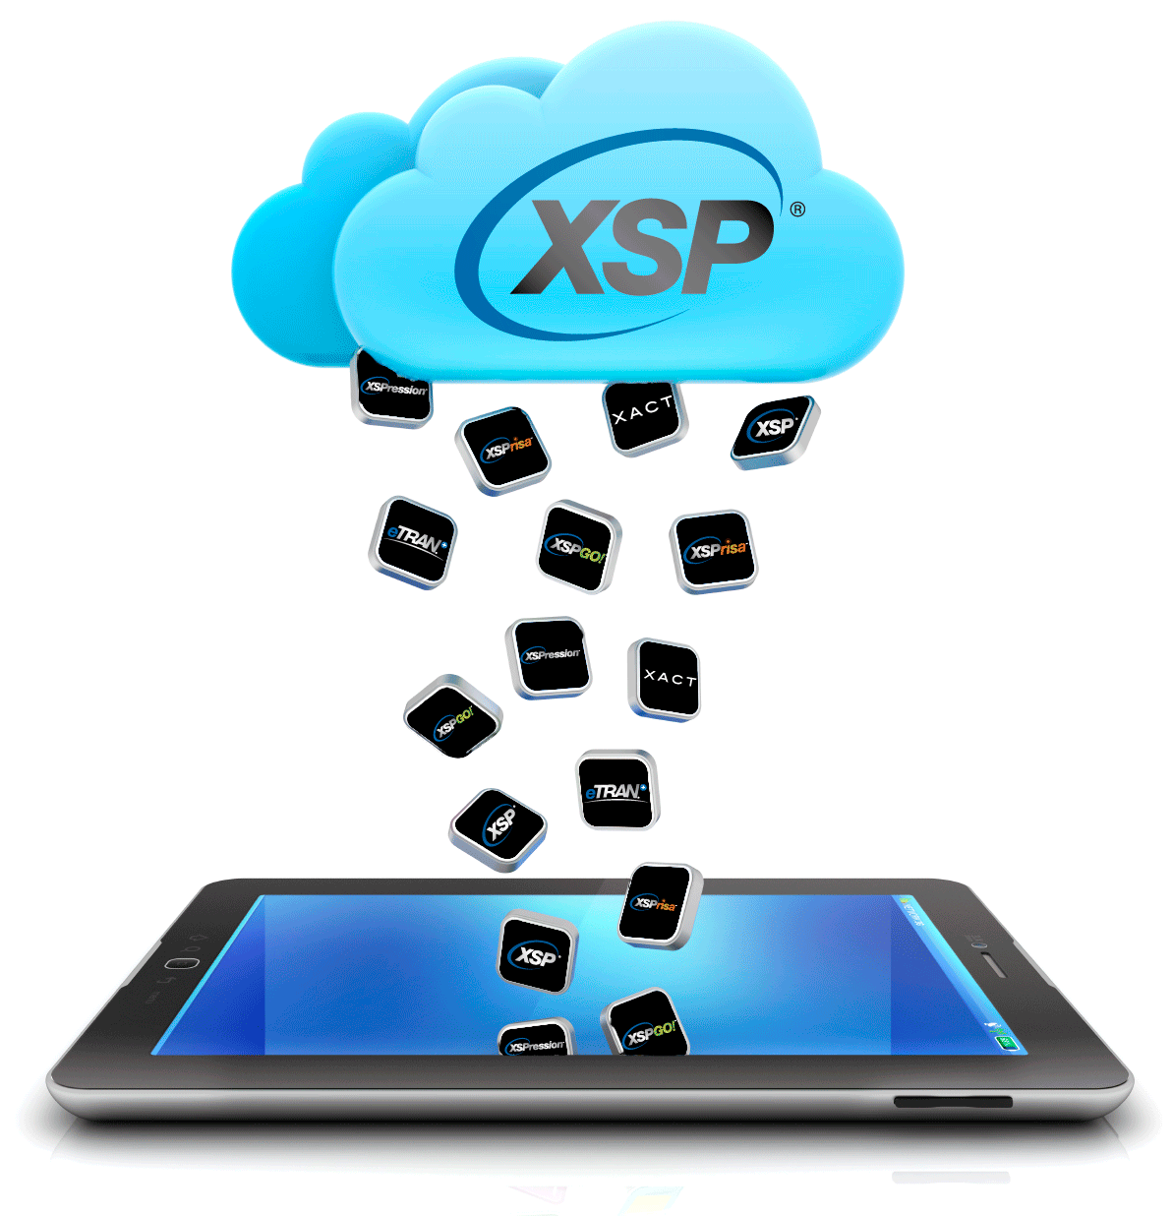
Thank You!

